Slide 1
TELUS
Business Case Analysis
Option 3
Siddharth Kapania
19 Oct 2020
Notes:
You can replace the background GIF putting in your own, or by searching through GIPHY.com

Slide 2
Introduction
Getting new customers is much more expensive than retaining existing ones, companies should reduce churn as a top priority.

Slide 3
Steps
Data Analysis
1
Data Cleaning
2
Model Selection
3
Model training and evaluation
4

Slide 4
Data Analysis
Initial findings
Using the correlation heatmaps, we discovered that most variables have correlation less than 0.1 with churnid variable.
All values in the column CusCare_flag were 'No'. Similarly, the column Num_calls_Cuscare has a mean and standard deviation of value 0. We discarded both these columns.
The dataset is imbalanced (80711, and 5971 examples respectively for the two classes).

Slide 5
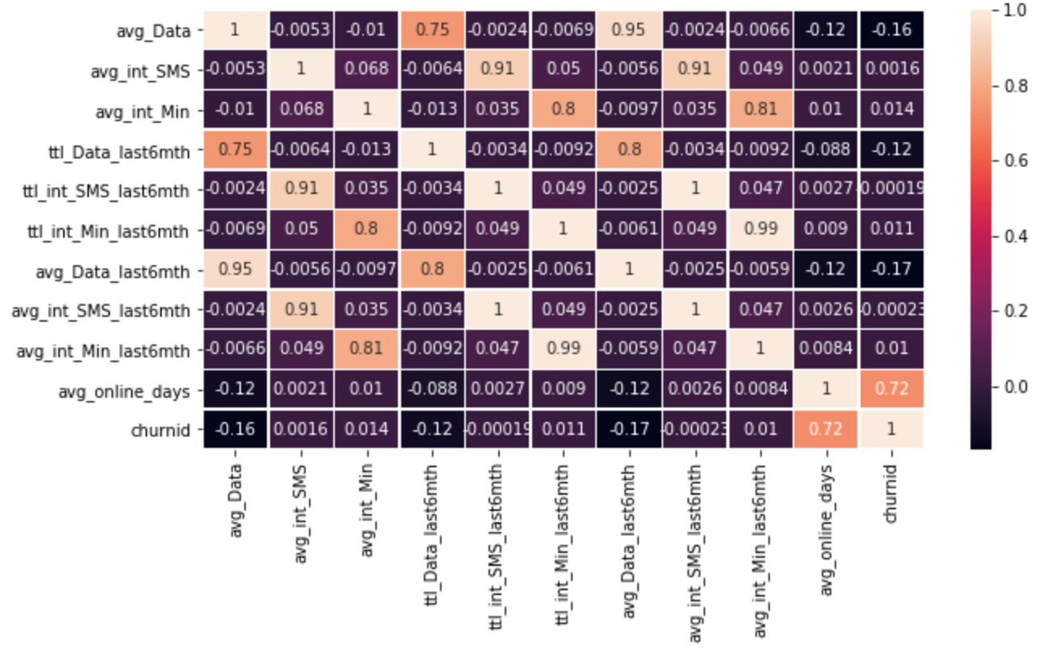
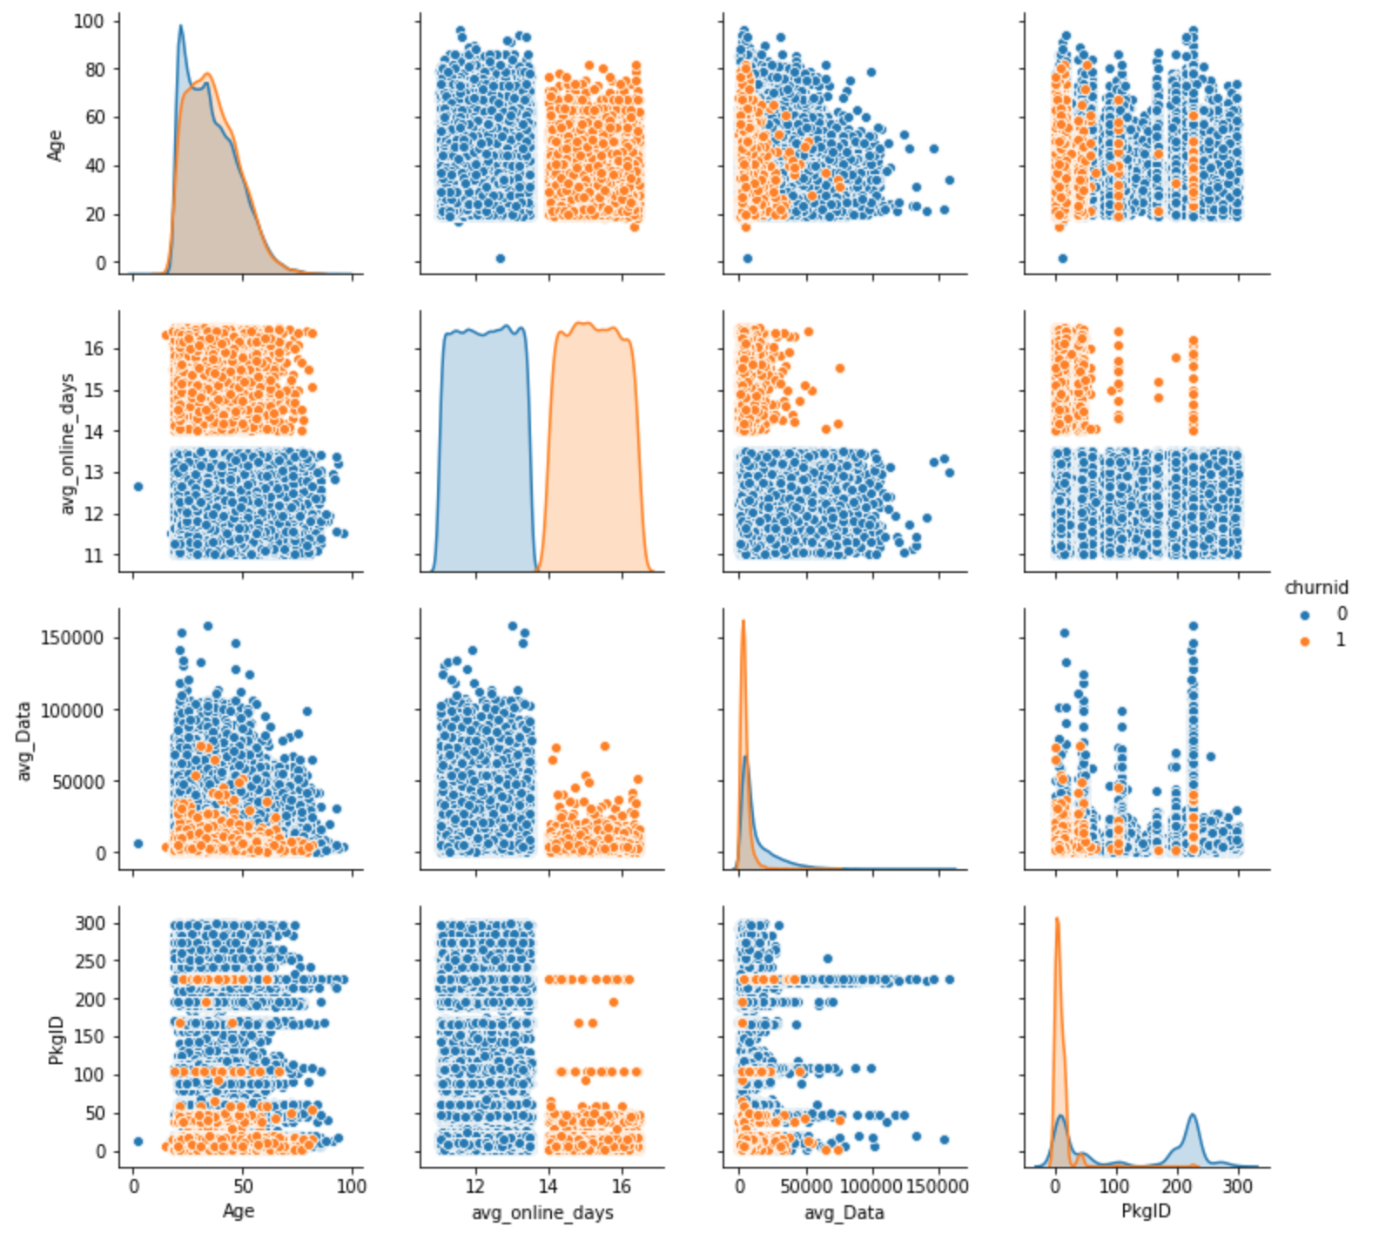
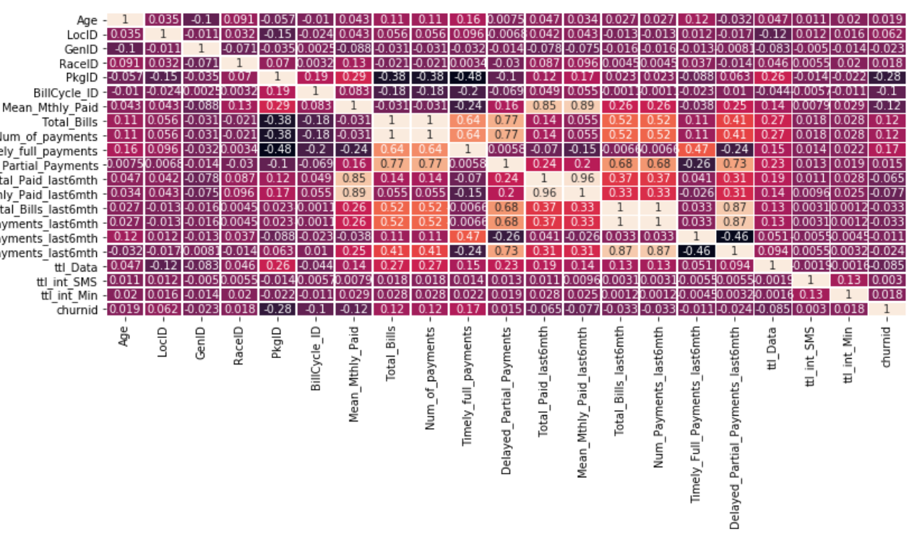

Slide 6

Model selection, training and evaluation
73%
Decision Tree
Accuracy
One of the most fundamental ML tool for classification and regression analysis.
Will help us fully understand how we can reduce the rate of churning.
Used Sklearn, Pandas, Seaborn and NumPy for the purpose of this task.
Confusion Matrix

Slide 7
Way Forward
Possible Optimizations
Using weighted sampling and balanced metrics for the dataset imbalance.
Using RandomSearchCV and GridSearchCV
Using a training/testing/validation split
These could result in improvement in metrics and overall ML system performance, eventually reducing the rate of churn for the organization.

Slide 8
Thanks!
Notes:
[You can replace the background GIF by searching through GIPHY.com]

